Slide 1


Women’s Tennis Association
Est. June 1973, London, UK
Gift Nhlenyama
Specialist Data Scientist

Slide 2


Key Considerations
Age
Ranking
Ramp up
Performance progression
Against Higher Ranked Players
Performance Metrics

Slide 3



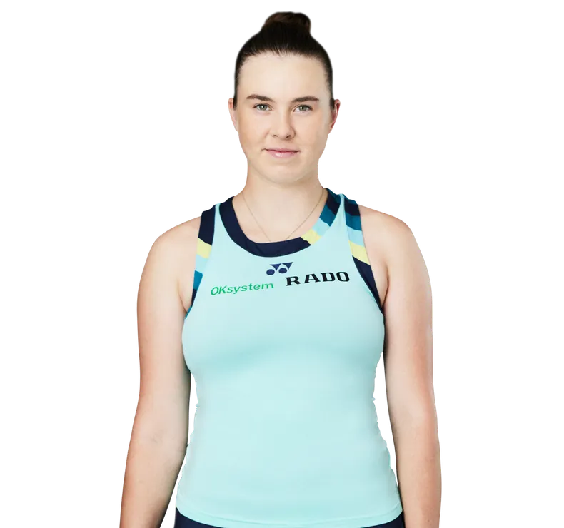
BP
Coco Gauff Age: 20 Rank: 3
Win%: 70,18%
Rank Change: 454 Consistency Index: 83,52%
1st Serve Win: 68%
2nd Serve win: 45,35% Serve Dominance: 59,25%
Qinwen Zheng Age: 22 Rank: 7
Win%: 64,88%
Rank Change: 164 Consistency Index: 73,02%
1st Serve Win: 75%
2nd Serve win: 45,69% Serve Dominance: 60,82%
Mirra Andreeva Age: 17 Rank: 19
Win%: 65,75%
Rank Change: 410 Consistency Index: 73,08%
1st Serve Win: 64%
2nd Serve win: 49,01% Serve Dominance: 58,25%
Linda Nosková Age: 19 Rank: 26
Win%: 58,06
Rank Change: 159 Consistency Index: 70,73%
1st Serve Win: 68%
2nd Serve win: 46,15% Serve Dominance: 58,50%

Slide 4

Rankings Per Year

